Slide 1
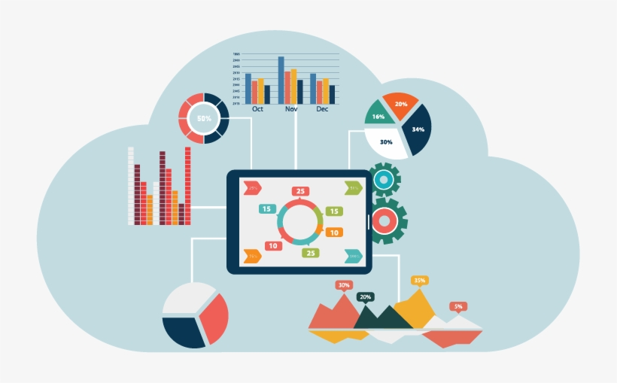
Bank Loan Analysis
Group no : 5
Group Members :
Roshan W Bambal
Gowtham K. G.
Usha.E
Belur Kartik Jagadeesh
Akkala Anuja
Mandar Pramod gotmare
B.m. Vinutha

Slide 2
Agenda
INTRODUCTION
DATA OVERVIEW
OBJECTIVE
ANALYSIS
INSIGHTS
CONCLUSION

Slide 3
Project Introduction
Bank analytics work with the people to help them to reach their financial objectives. Their client includes government, small and middle sized enterprises, individual and big organization. In addition to banking, we also provide investment management and other financial and risk management services and product.
The data corresponding to the project deals with the personal details, professional and credential background of the customers of the bank,. where we were provided with 1 datasets with .csv extension files and second is excel file having 39k+ records each and the objective was to analyze the growth that bank got within given years in loan.

Slide 4
Data Overview
Analyze a bank's multi-year loan growth using 39k+ records. Uncover trends, provide actionable insights through statistical analysis, and present findings visually for optimized lending strategies.
We used MS-Excel, MySQL for analyzing, cleaning and removing duplicates from dataset and prepared dashboard using Tableau and PowerBI tools where we did calculations, merging and prepared interactive dashboards.

Slide 5
Objectives
The main goal was to take a handful of important performance metrics (KPIs) and turn them into easy-to-understand visualizations. The aim was to create clear charts and graphs that not only tackled the specific KPIs given but also made it simple for everyone to grasp how the company was doing. This objective pushed us to enhance our data analysis skills and communicate insights visually, helping to make better-informed decisions based on the data.

Slide 6
KPI’S
KPI-1 : Year wise loan amount Stats
KPI-2 : Grade and sub grade wise revol_bal
KPI-3 : Total Payment for Verified Status Vs Total Payment for Non Verified Status
KPI-4 : State wise and month wise loan status
KPI-5 : Home ownership Vs last payment date stats

Slide 7
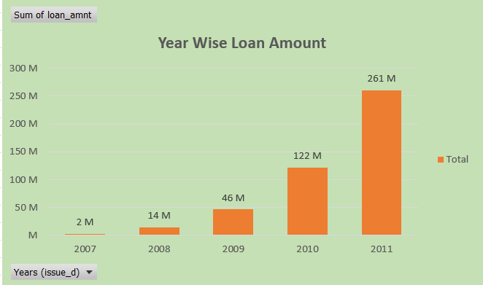
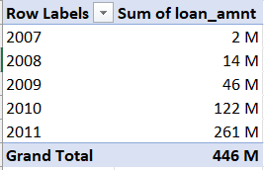
KPI-1
Year wise loan amount Stats :
By observing the chart we can see how Loan Amount is increasing by year.
Starts from 2007 the loan amount is 2M+ and in the 2011 the loan amount is 261M+. We can subtract the new value to the old value to see the difference
26,05,06,575 - 22,19,275 = 25,82,87,300
258287300 increased in the duration of 4 years
And Grand Total of all years is 446M+.

Slide 8
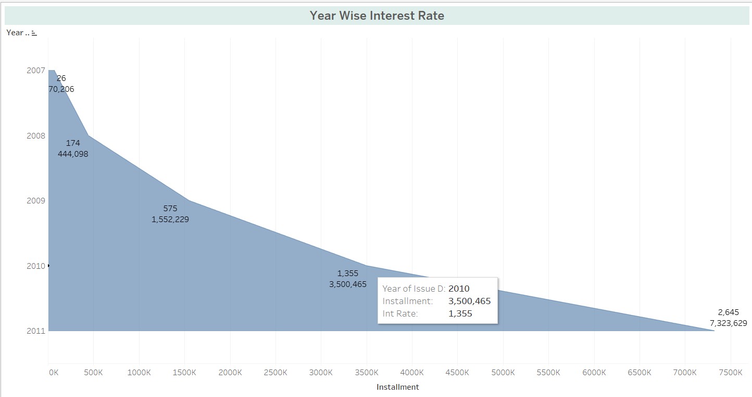
KPI-1 Sub-Charts
In this chart interest rate and dept installments both are increasing year by year As interest rates move up, the cost of borrowing becomes more expensive

Slide 9
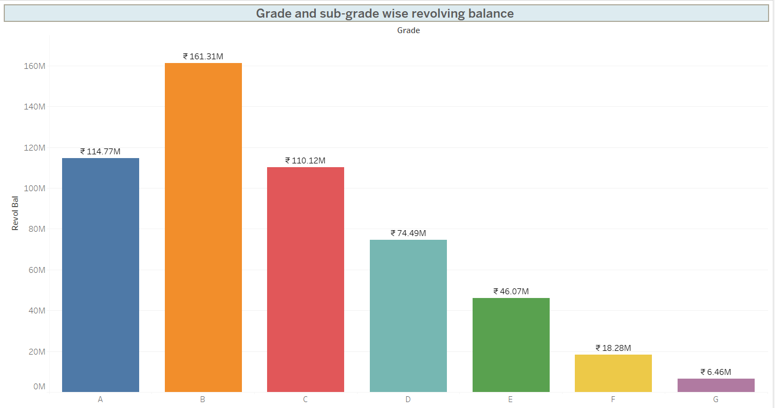
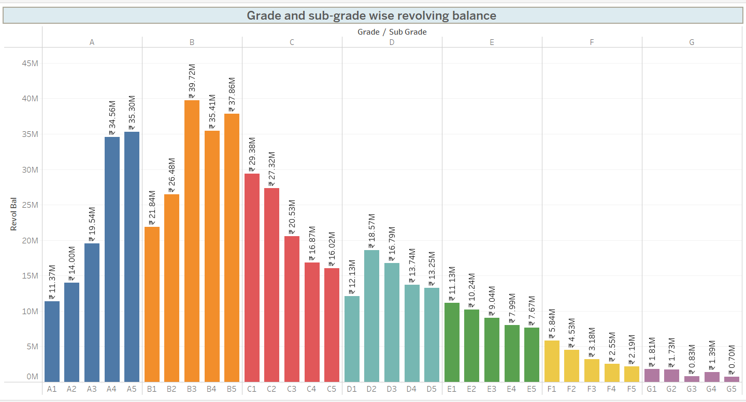
KPI-2
Grade and sub grade wise revol_bal :
In this Grade and subgrade wise revol balance we can notice Grade-B have more revol balance then any other grade & Grade-G have very low revol balance.
As we can see that Grade B customers has higher annual income for 10+ yrs of employment period, so higher the annual income lower the Debt to income ratio and hence, more number of customers took loan in Grade B .
Similary, it goes for other grades also B>A>C>D>E>F>G order for revol bal as per annual income

Slide 10
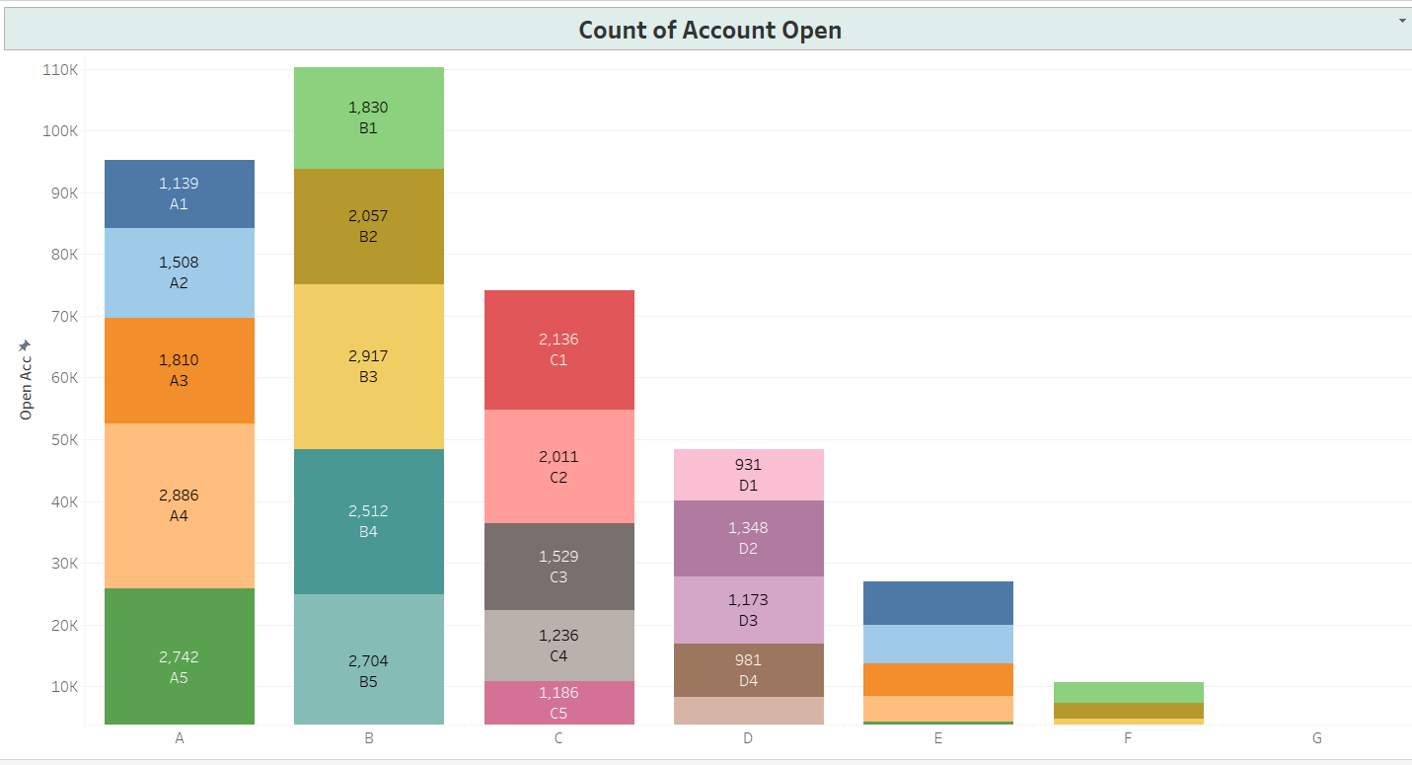
KPI-2 Sub-Charts
Count of Accounts open in All Grades are 39717 Total

Slide 11
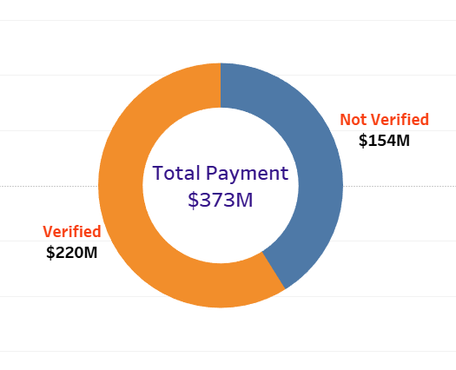
KPI-3
Total Payment for Verified Status Vs Non Verified Status :
This is the first stage of the verification process. The bank needs a loan application to initiate the document collection and verification process
Looking at pie chart we can observe that verified status have $220 M of total payment and $154 M of total payment which are Not Verified for the Loan Amount

Slide 12
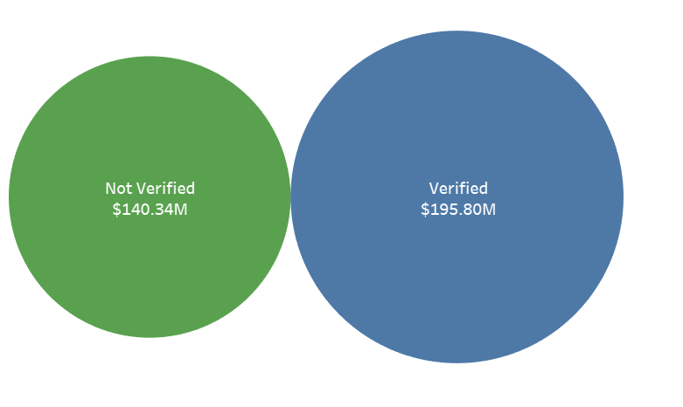
KPI-3 Sub-Charts
Funded Amount Status
This Ratio shows us how many people are non verified with there Total funded amount 140.34M similarly Verified with 195.80M total funded amount

Slide 13
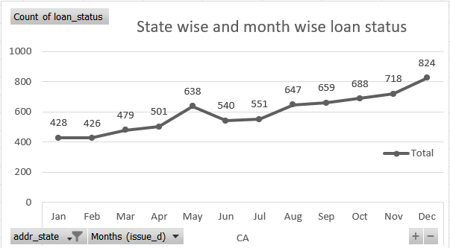
KPI-4
State wise and Month wise loan status:
Month Wise Loan Status
The visualization shows three loan statuses: Charged Off, Current, and Fully Paid, with December having the highest number of Fully Paid accounts and January having the lowest.
Understanding monthly loan variations is crucial for managing and strategizing, and investigating factors like external economic events or operational changes can optimize loan management and customer engagement strategies.
The visual representation reveals fluctuating loan status accounts over 12 months, with December having the highest number of Fully Paid accounts and January having the lowest.

Slide 14
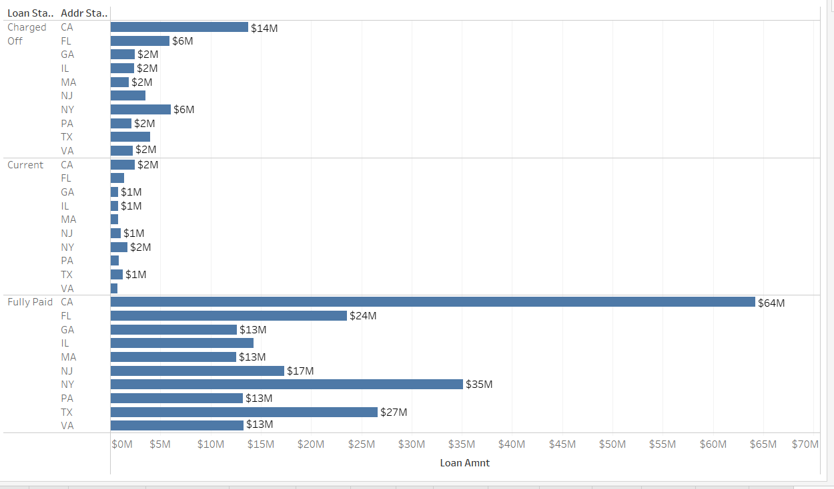
KPI-4 Sub-Charts
The graph shows the Top 10 states to whom bank gave the highest amount of Loan.
Here , it is clearly seen that in top 10 states, CA has given highest amount of loan to customers. But, maximum of customers in each state has fully paid status followed by Charged off and current.

Slide 15
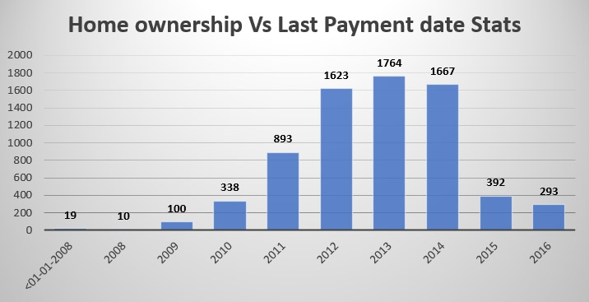
KPI-5
Home_ownership vs last payment date stats:
The right graph shows the Home ownership and the amount paid for each on last payment date.
Here, we can see that maximum latest amount paid by customers with MORTGAGE home ownership is Rs.310,798.
It concludes that many of the customers are about to repay their loan amount for their particular home ownership.

Slide 16
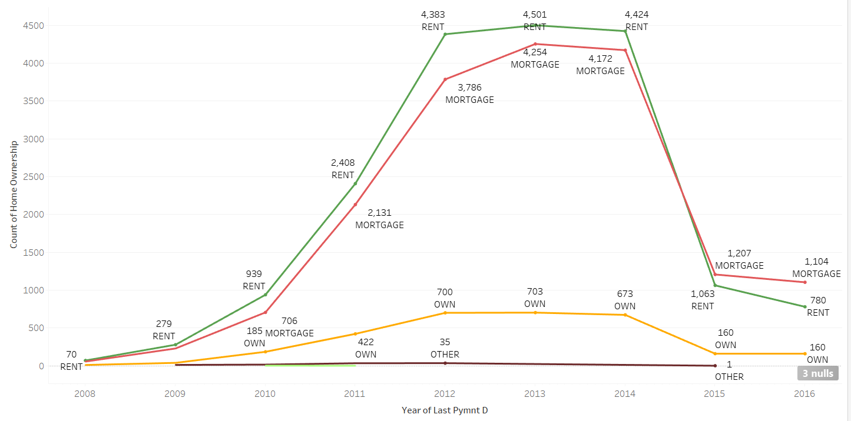
KPI-5 Sub-Charts
As we saw that last payment loan amount is paid highest by mortgage for latest date. Here, the right graph shows the total loan took by customers for each home ownership with int and amount paid to the bank and their loan status.
We can conclude that in each home ownership, maximum loan is taken for debt_consolidation and also customers who took loan for this purpose has repaid in mass amount.
Except NONE and OTHERS, all other Home_ownership has maximum took loan for debt_consolidation. So, recently paid max amount is of MORTGAGE followed by RENT and OWN.

Slide 17

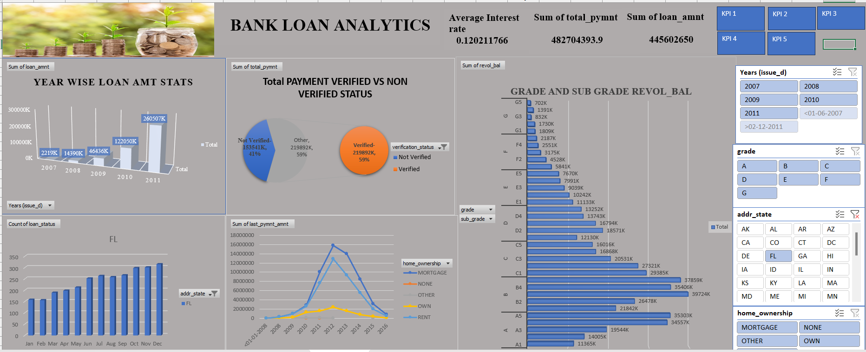

Slide 18

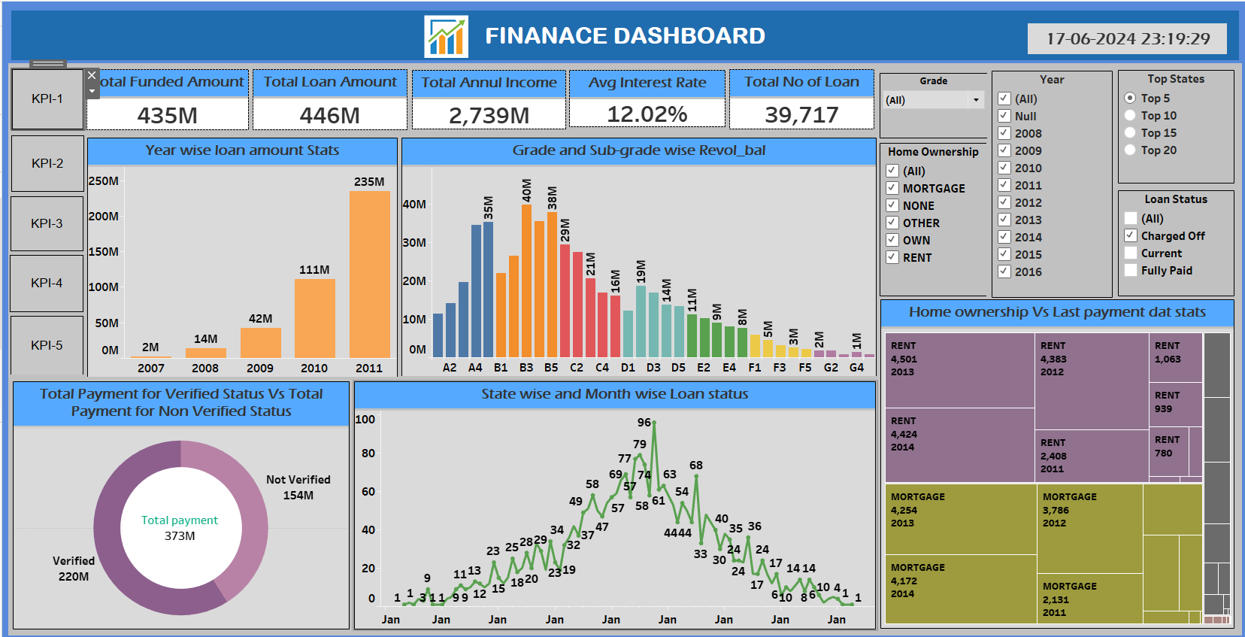

Slide 19

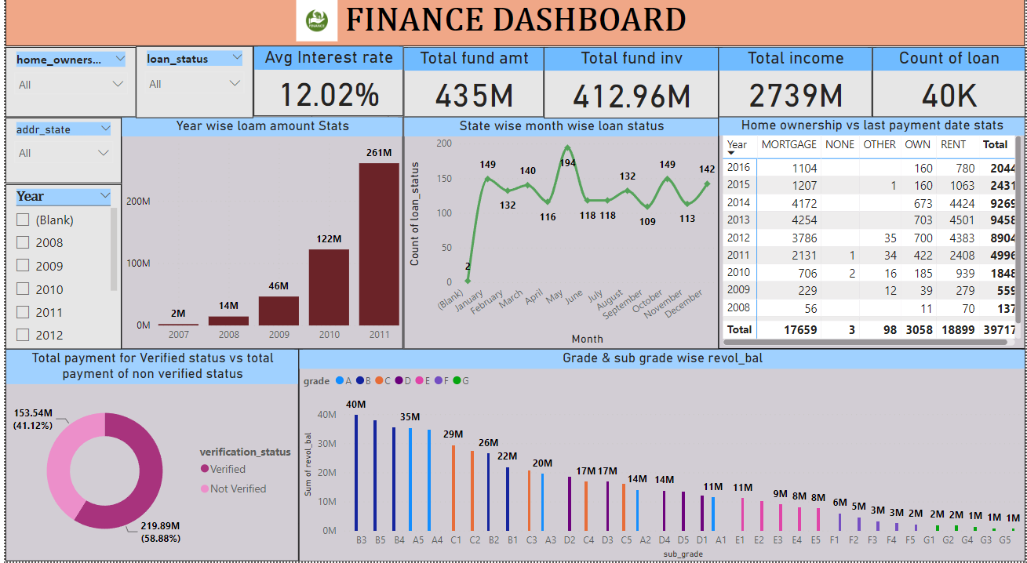

Slide 20
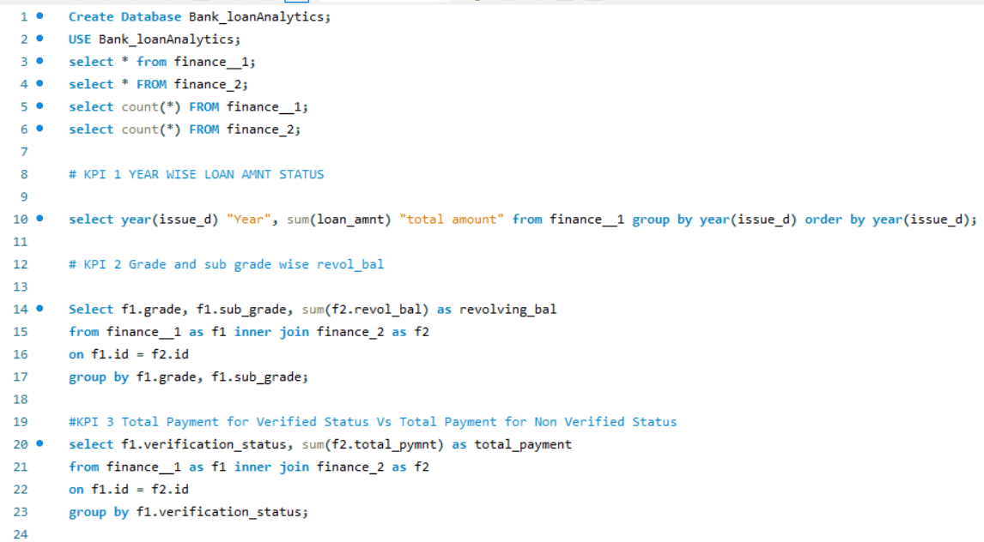
MySQL- KPI 1-3

Slide 21
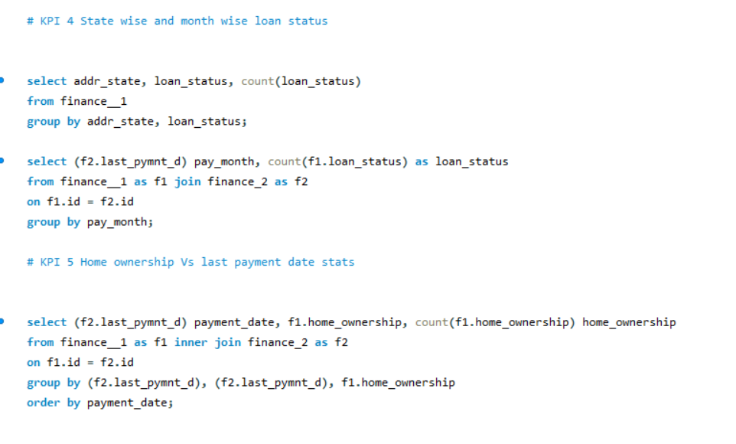
MySQL- KPI 4-5

Slide 22
Insights:
We can clearly see that there is gradual increase in loan amount taken from one year to another year.
Revol_bal is more in grade B customers and least in grade G customers.
The data indicates a clear distinction in total payments between verified and non-verified status. Verified accounts, comprising 41.12% of the total, have contributed $153.54 million, while non-verified accounts, representing 58.88%, have contributed $219.89 million.
Fully Paid had the highest total Count of loan_status at 32,950, followed by Charged Off at 5627 and Current at 1140.
Across all 5 home ownership. Count of last payment range from 3 to 18,899.Rent accounted for 47.54% of last payment.And none has least last payment count.

Slide 23
Recommendation
Expand Marketing Efforts: Increase marketing efforts to attract a larger pool of potential borrowers, advertising campaigns to raise awareness about the bank's loan products.
Targeted Marketing Campaigns: Identify segments of customers who are likely to benefit from revolving credit products and tailor marketing efforts to reach them effectively.
Partnerships and Alliances: Collaborate with reputable financial institutions, industry associations, and regulatory bodies to strengthen the bank's credibility and network.
Automated Data Integration: Invest in automated systems that seamlessly integrate with the bank's database to collect loan data in real-time.
Flexible Mortgage Products: Offer a range of mortgage products with flexible terms and down payment options to cater to diverse financial situations.

Slide 24
Conclusion
In our daily lives, banking is very important. We can extract hidden insights from the examination of the dashboards and reports above by applying knowledge gleaned from finance datasets and KPIs. Decisions about the business are made accurately and are able to monitor its status. It permits an all-encompassing perspective of the company, bolstering long-term expansion and competitiveness within the banking sector

Slide 25
Thank You

